Slide 1
Northwind Data Analysis - Mod 2 Project
File created on: 4/5/2019 11:00:12 PM

Slide 2
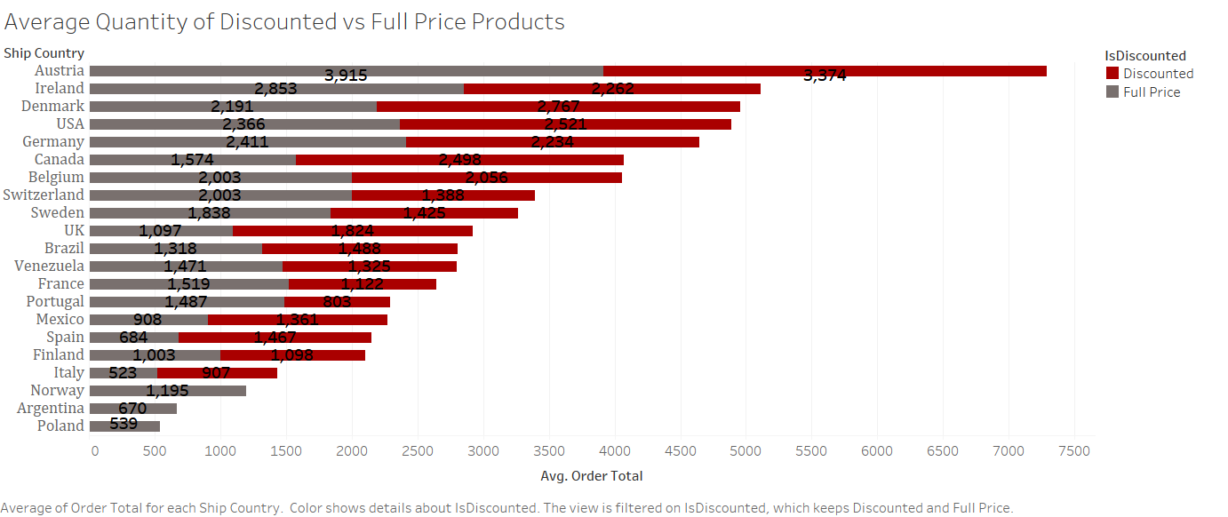

Slide 3
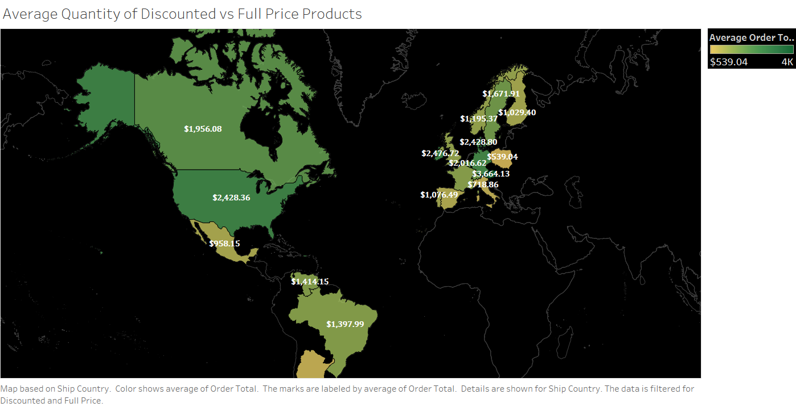

Slide 4
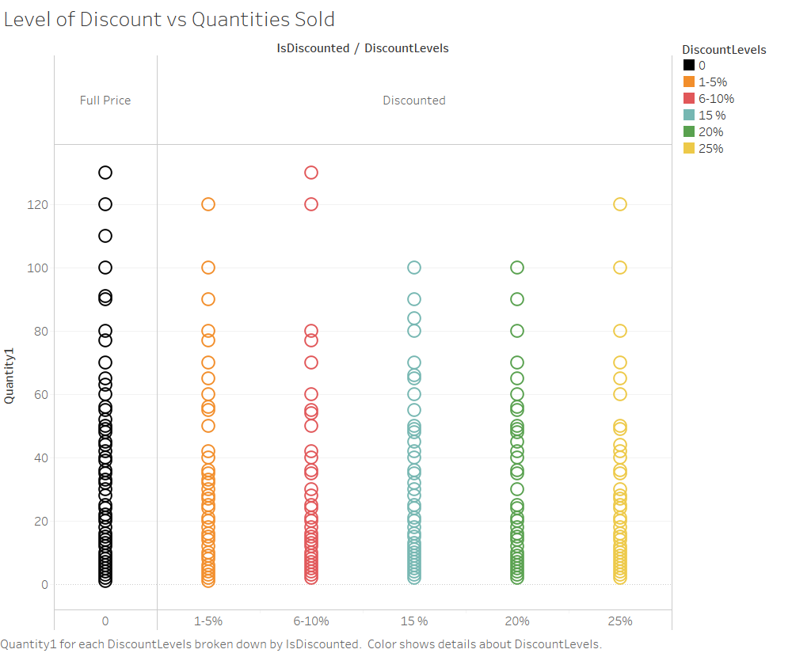

Slide 5
